Slide 2
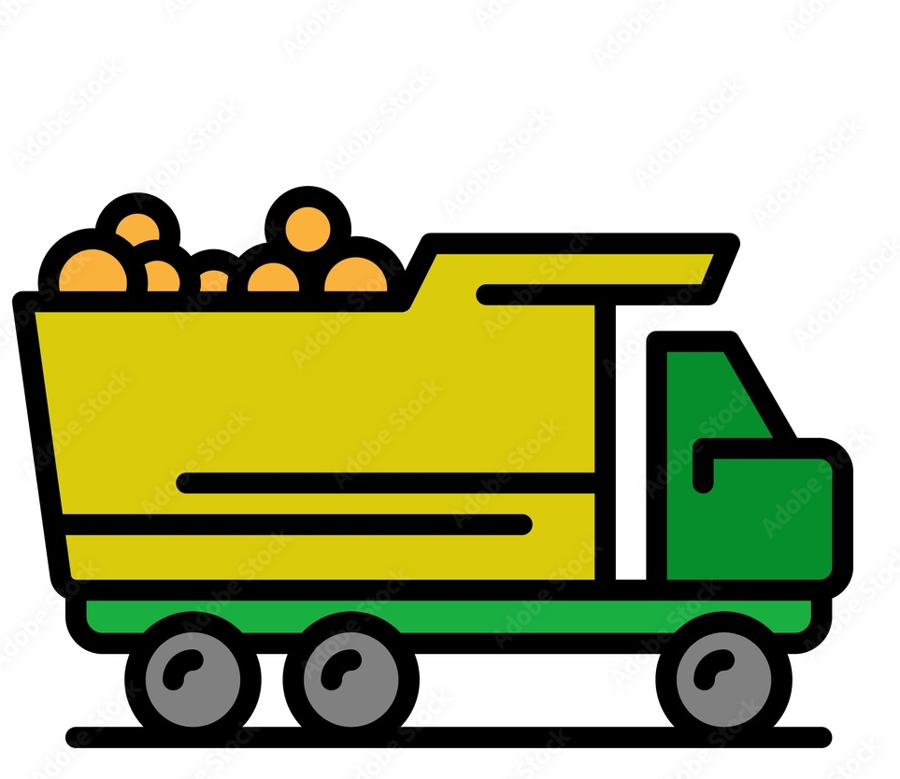
Background
Your Shipment value is 10,000 Dh
Wholesale food Market
Farm
Here is your 4.5%
Pay me 7%
To other Markets
Weight-in
Government
Al Wakil
Customers
Retailers
Notes:
Use it as a story of a wakil using a meeting with a wakil …! Then the story of one product life !!!

Slide 3
Problems
Many unnecessary workers under the wakil (>50%)
-> High HR cost and management difficulties
Limited or No communication between Wakils
-> Conflicting Prices and unfair competition
Repeated action in writing, storing, confirming data using many documents
-> Time wasting and work inefficiency

Slide 4
Solution
Mobile App
specific for the wakil to help him transition from manual, time-consuming processes to a modern, digital approach, ensuring accuracy, speed, transparency

Slide 5
Market Analysis
75 possible Wholesale markets nationally
10 wholesale markets with more than 10 Wakils
First Targets: Fez then Marrakech wholesale markets

Slide 6
Customers
1. Wakils (B2C):
Role: oversee and facilitate transactions
Needs: Efficient management tools.
Offer: A digital platform that enhances their activity
2. Investors (B2B):
Role: Collect data to inform investment decisions.
Needs: reliable, analyzed, and actionable market data.
Offer: A rich database of market trends and insights
+ Future: Consultation and advises based on data analysis and predictive models

