Slide 1
BIOCAMEL
Moroccan Nomadic Flavor in Every Bite !
AMEURAOUI Oussama ©
Founder of BIOCAMEL

Slide 2
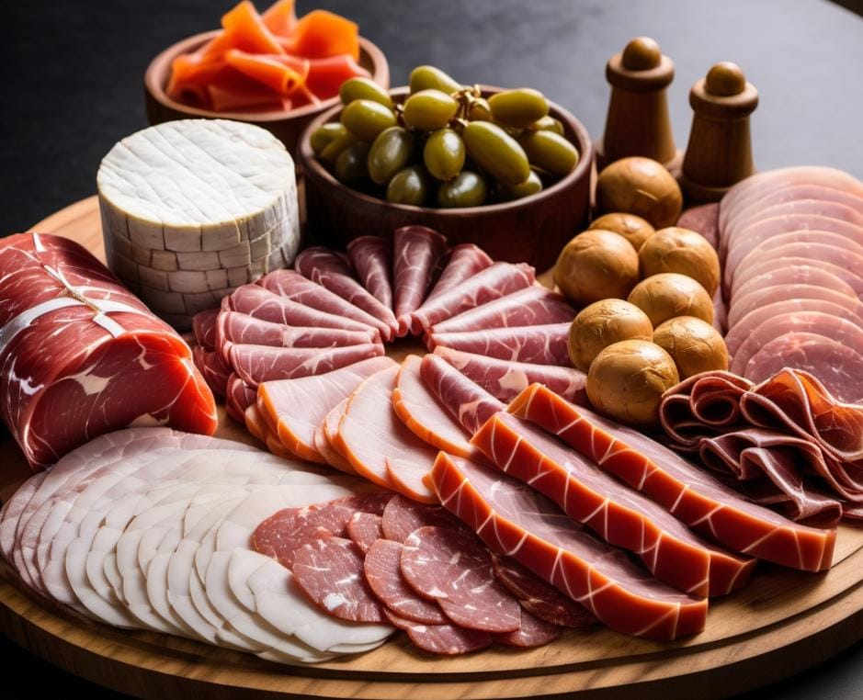
Introduction to BioCamel

Slide 3
Meeting the Demand for Nutritious and Unique Food
Traditional meat sources may not always align with the needs of health-conscious and ethically-driven consumers.
(The Camel Meat Market size is projected to increase by USD 100.83 million and the market size is estimated to grow at a Compound Annual Growth Rate of 6.32% between 2023 and 2028.)
There's a growing appetite for innovative and distinctive food options.

Slide 4
Introducing BioCamel
BioCamel offers a range of premium products derived from camel meat, known for its high iron content and low cholesterol.
This includes Gouda cheese and various charcuterie options.
Iron Content (mg/100g):
Beef: 2.1
Chicken: 0.9
Pork: 0.7
Lamb: 1.4
Camel: 3.6
Cholesterol Content (mg/100g):
Beef: 73
Chicken: 85
Pork: 71
Lamb: 78
Camel: 60

Slide 5
Value Proposition of BioCamel
Nutritious and Unique Food Products
High Iron and Low Cholesterol Camel Meat
Quality Gouda Cheese and Charcuterie
Sustainability and Ethical Sourcing

Slide 6
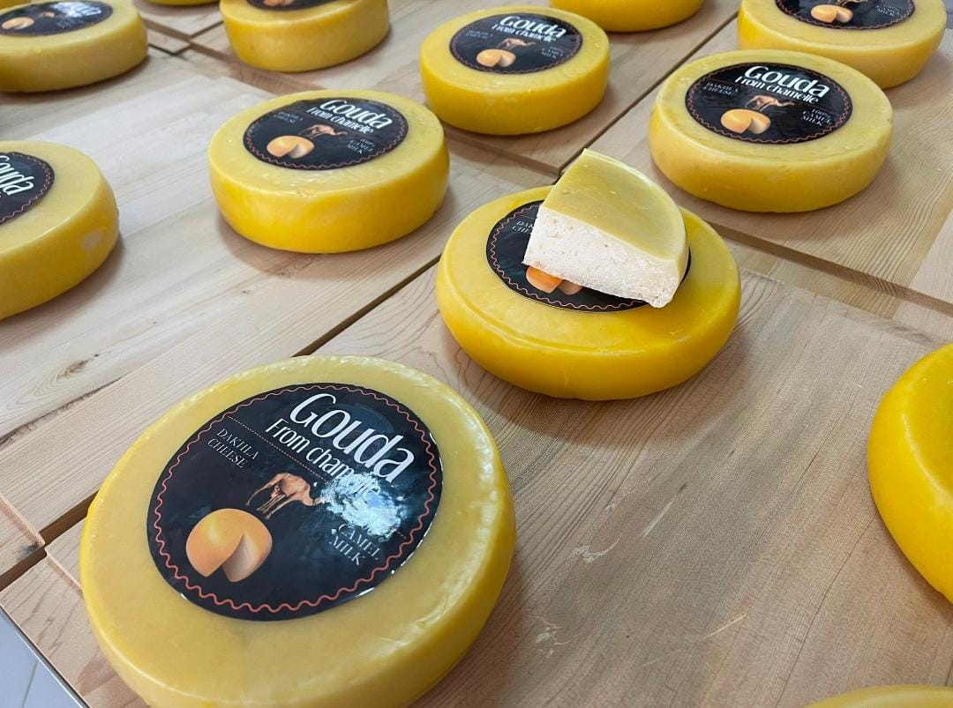
GOUDA CHEESE

Slide 7
CAMEL CHEESE
Camel Milk Feta: A tangy, crumbly cheese with a distinctive flavor, often used in salads, pastas, and as a topping.
Camel Milk Halloumi: A semi-hard, white cheese with a high melting point, perfect for grilling or frying. It has a mild, salty taste.
Camel Milk Ricotta: A soft, creamy cheese ideal for spreads, fillings, and desserts. It has a mild, slightly sweet flavor.
Camel Milk Labneh: A strained yogurt cheese, creamy and tangy. It can be used as a dip, spread, or in various recipes.
Camel Milk Gouda: A semi-hard cheese with a mild, nutty flavor. It's versatile and can be used in a variety of dishes or enjoyed on its own.
Camel Milk Camembert/Brie: Soft, creamy cheeses with a rich, earthy flavor. They are often served as appetizers or on cheese boards.
Camel Milk Blue Cheese: A pungent, veined cheese with a strong flavor. It can be used in salads, dressings, or enjoyed on crackers.
Camel Milk Parmesan: A hard, aged cheese with a sharp, nutty flavor. It's often grated and used as a topping for pasta dishes.
Camel Milk Cheddar: A firm cheese with a rich, full-bodied flavor. It can be sliced, grated, or melted in various recipes

Slide 8
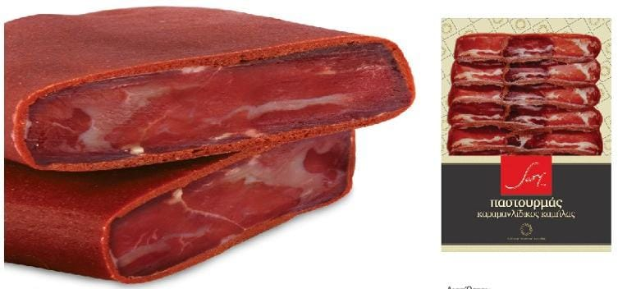
Camel Pastrami
PASTOURMA FROM CAMEL MEAT IN SLICES SARY 100GR.
Pure ingredients,
Pastourma of camel meat is scarce.
It is a light red meat and extremely tender and delicious.

Slide 9
CAMEL COLD CUTS
Camel Salami: Ground camel meat mixed with spices, cured, and dried. It can have a robust, slightly gamey flavor.
Camel Pastrami: Thin slices of camel meat, seasoned with herbs and spices, then smoked or air-dried. It offers a smoky, savory taste.
Camel Bresaola: Lean camel meat, air-dried, and seasoned with a mixture of herbs and spices. It has a tender, slightly gamey flavor.
Camel Prosciutto: Salted and air-dried camel meat, often served thinly sliced. It can have a rich, intense flavor.
Camel Jerky: Thin strips of camel meat that are seasoned and dried. It's a convenient, high-protein snack option.
Camel Pepperoni: Spiced and smoked camel sausage, typically used as a pizza topping. It can add a zesty, slightly spicy kick.

Slide 10
Target Audience for BioCamel
Health-conscious Consumers
Gourmet and Specialty Food Enthusiasts
Sustainable and Ethical Consumers
Innovative Food Explorers
Culinary Professionals and Chefs
Health Food Stores and Specialty Retailers
Ethnic and Cultural Markets

Slide 11
Distribution Channels for BioCamel
Retail Stores
Online Marketplaces
Specialty Food Stores
Direct Sales (Farmers' Markets, Events)

Slide 12
Revenue Streams for BioCamel
Sales of Camel Meat and Charcuterie
Sales of Gouda Cheese
Potentially, Licensing or Partnership Agreements

Slide 13
Core Activities of BioCamel
Camel Meat Processing
Cheese Production
Research and Development for Product Innovation
Marketing and Promotion

Slide 14
Critical Resources for BioCamel
Camel Farms and Livestock
Cheese-Making Equipment
Skilled Labor (Butchers, Cheesemakers)
Research and Development Team

Slide 15
Cost Structure for BioCamel
Camel Farming and Maintenance
Labor Costs for Processing and Production
Equipment and Infrastructure
Research and Development Expenses
Marketing and Promotion

Slide 16
Shaping the Future of Healthy Eating with BioCamel
We believe that BioCamel is not just about food; it's about making a positive difference in how we eat.

Slide 17
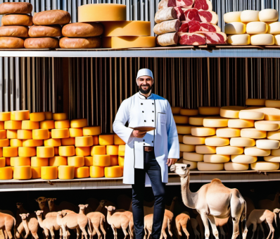
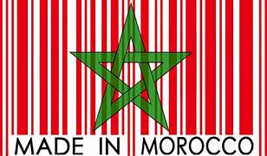
BIO-CAMEL
Moroccan Nomadic Flavor in Every Bite !

Slide 18
Questions and Answers

