Slide 1
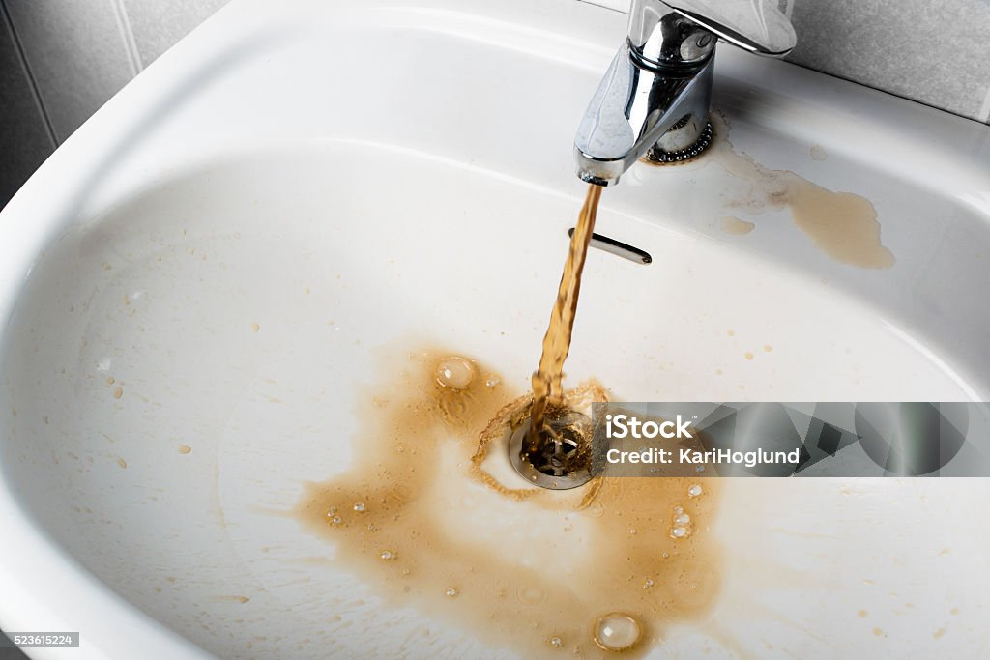

Filtering the Lives
Notes:
. I'm thrilled to introduce you to NanoDrop, a groundbreaking solution that promises "New Life with Each Drop."

Slide 2

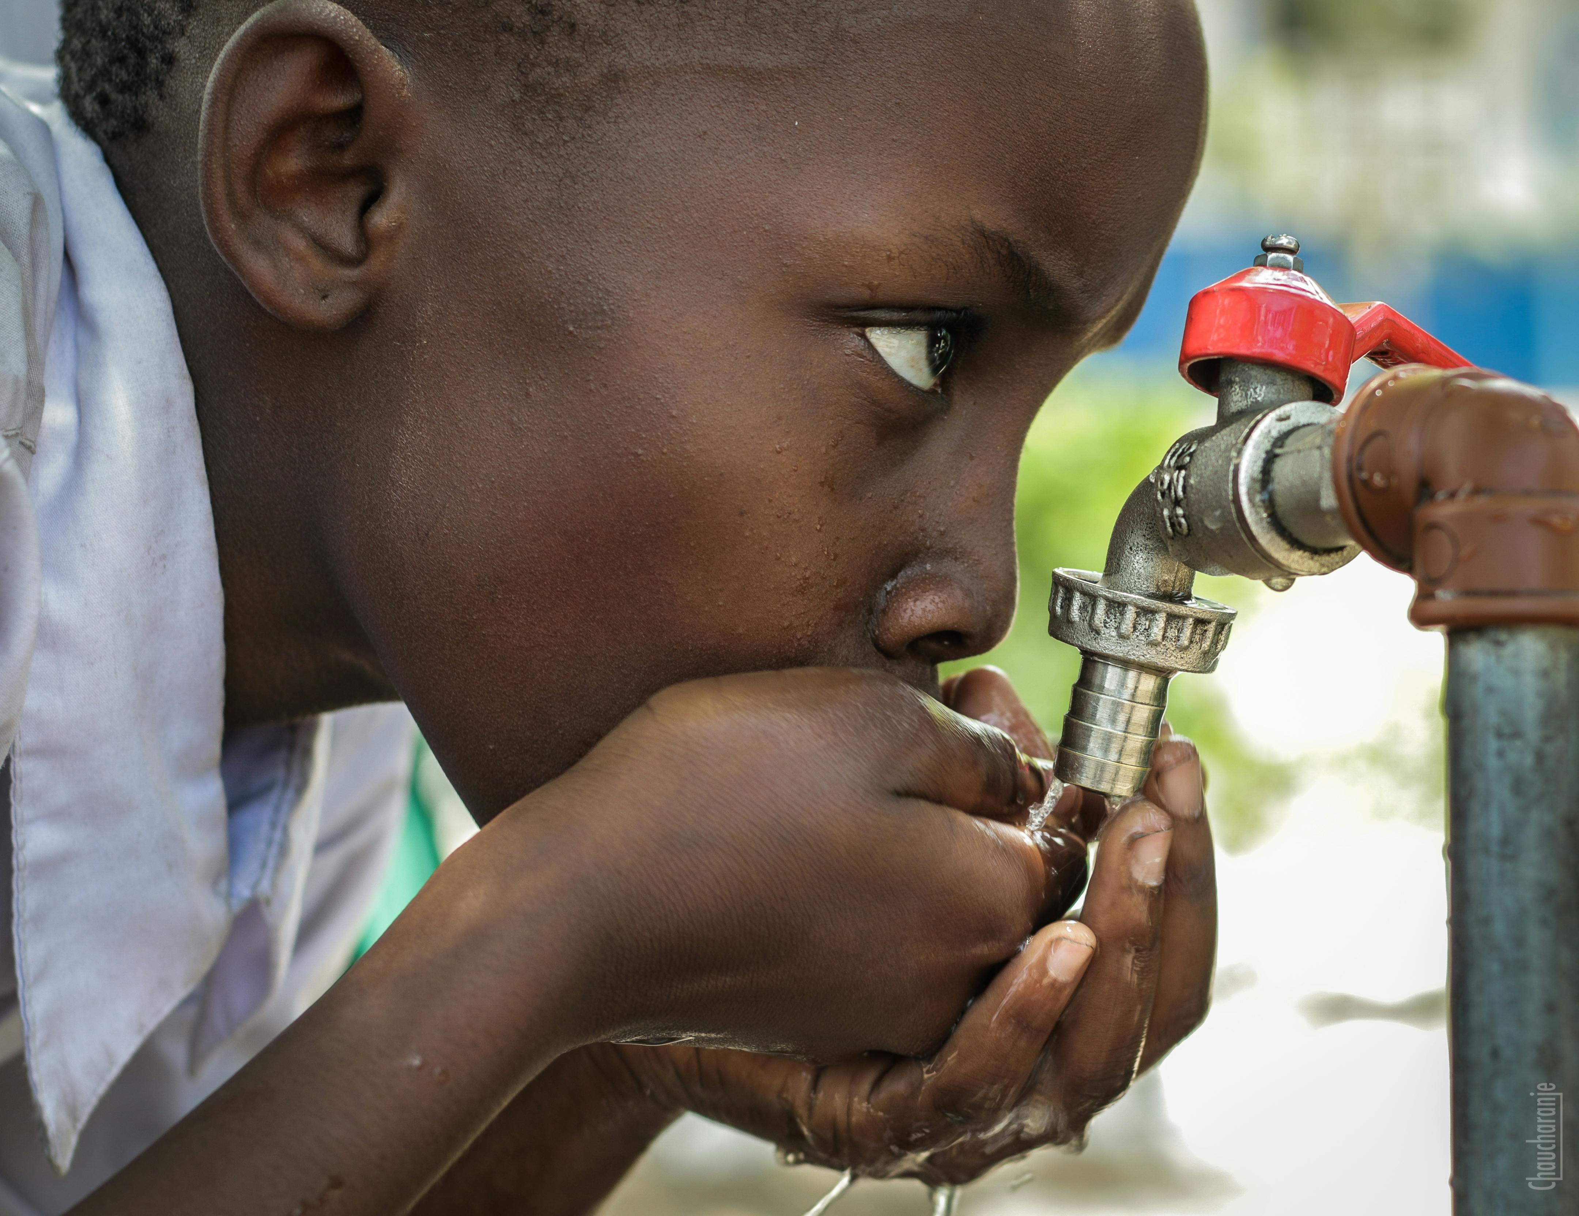
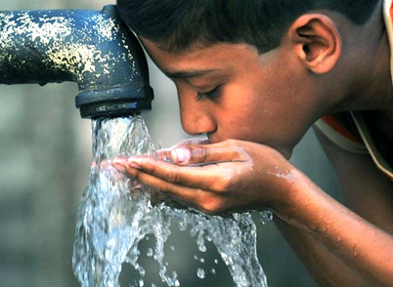

Problem…
2 Billion Lack Access Clean To Water Worldwide
1 Out Of 3 Ppl In Africa Lack Access To Clean Water
20% Moroccan Pop. Do Not Have Access To Clean Water
https://www.macrotrends.net/countries/MAR/morocco/clean-water-access-statistics

Slide 3
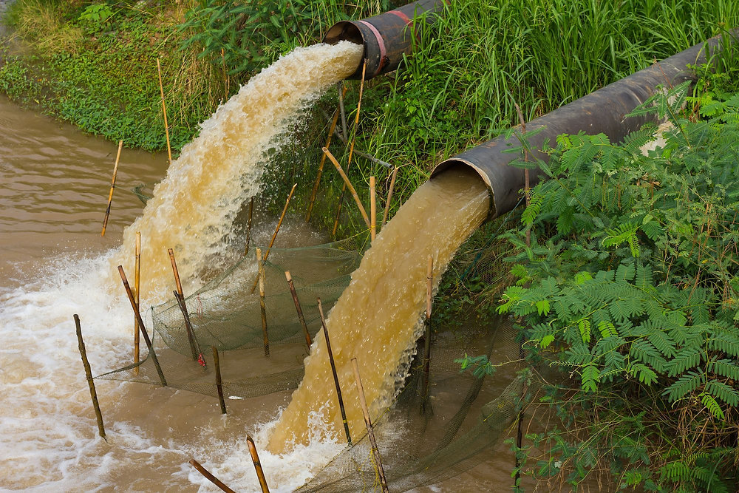
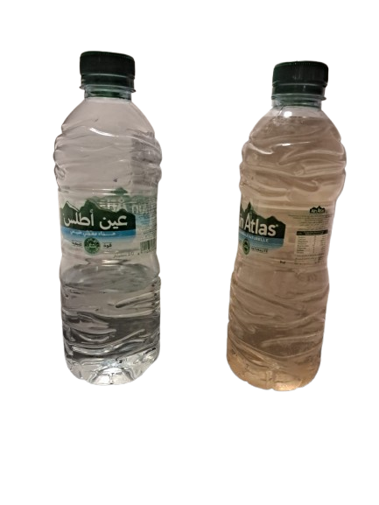

Benguerir Population lacks Access To Clean Water
Salty Nature
Drinking Water Quality in Benguerir
Bad Taste
Contaminants
Sample Water of Benguerir (Taken at Night)
Filtered Drinking Water

Slide 4
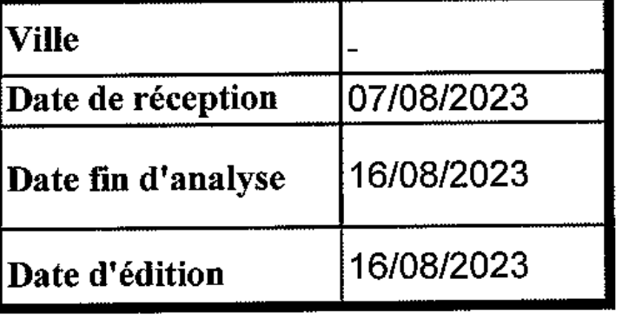
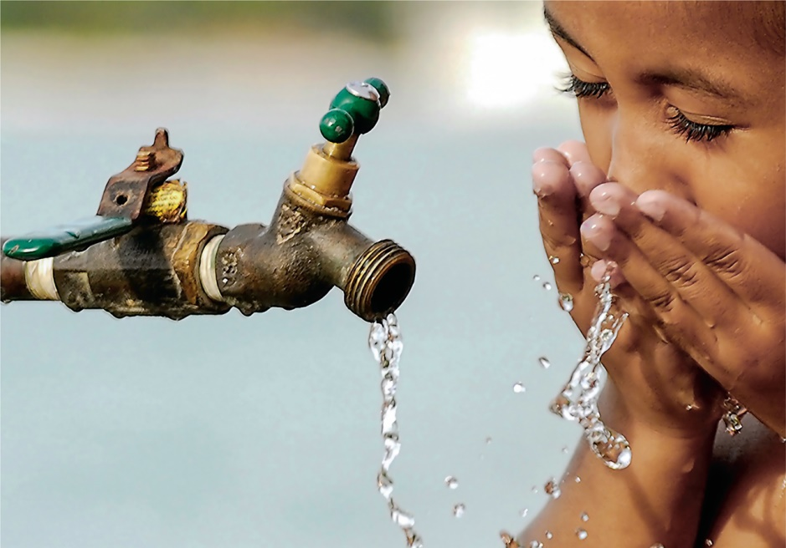
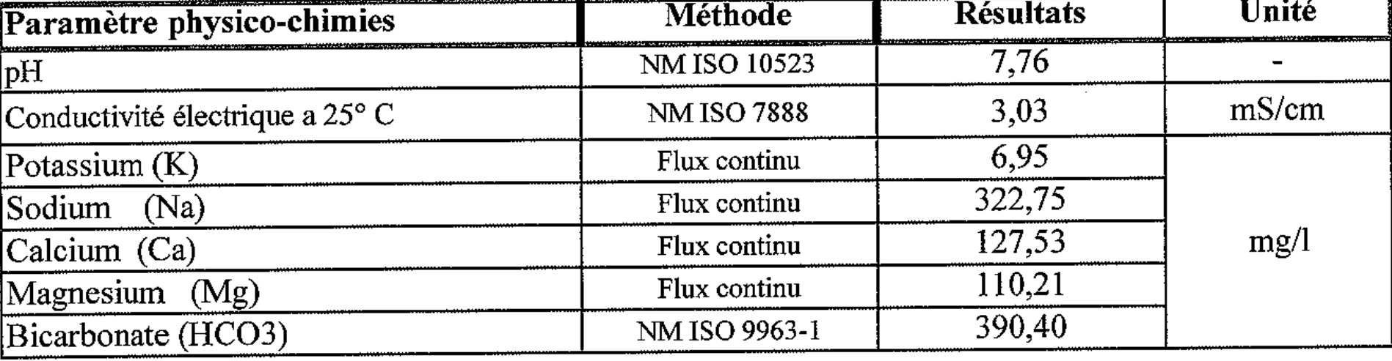
Water Quality Report (BenGuerir City)
Poor Water Quality
Description | Water Quality | Remarks | Liters of water/day
P1: Citizen | Water tastes salty | Available filters are expensive | About 3.7 liters
P2: Citizen | Calcaire | Price of Filters (1500 dh) | -
P3: Citizen | Bad quality of water! | Problem with teeth Price: 2000 dh | About 2-3 liters
P4: Engineer | Salinity of water | Filters of 700dh with lifetime of 6 months | About 2.5 liters
P5: Engineer at OCP | Water tastes salty | Price of filters between 500-1000dh | 2-4 liters
P6: Citizen | Taste and smell of water are bad | - | -
P7: Citizen | Color of water and some particle follow with water | Problem with teeth Need filter with low price | -
P8: Employee at UM6P | Bad quality of water | Buy bottle of water | -
Customer Survey
✓

Slide 5



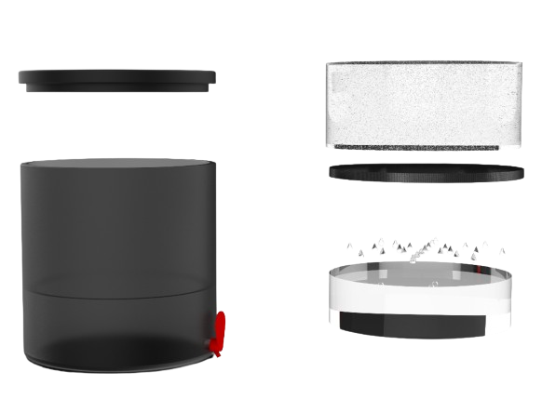
Solution
Filter without Electricity
Economical Filter
Value Proposition
Without Electricity & Portable
Above 90% Efficiency Cleaning Tap Water
1000x Better
Low Cost
(Under 50 Euros)
Lifespan of ~10 months

Slide 6
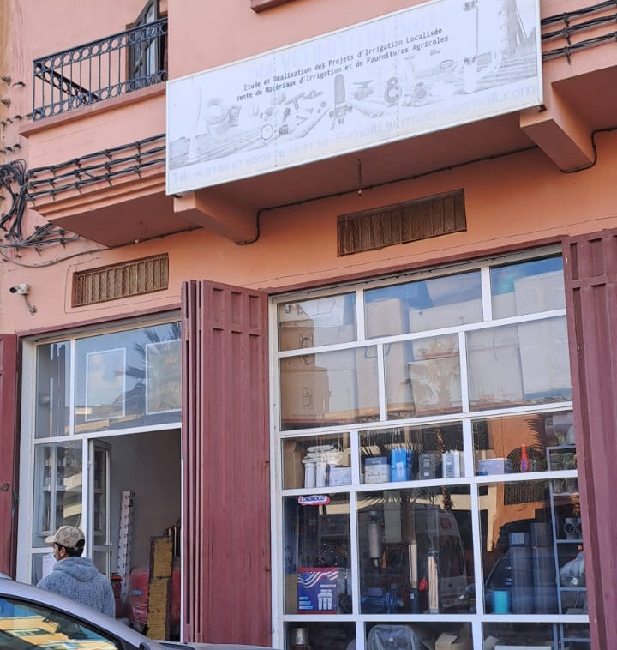
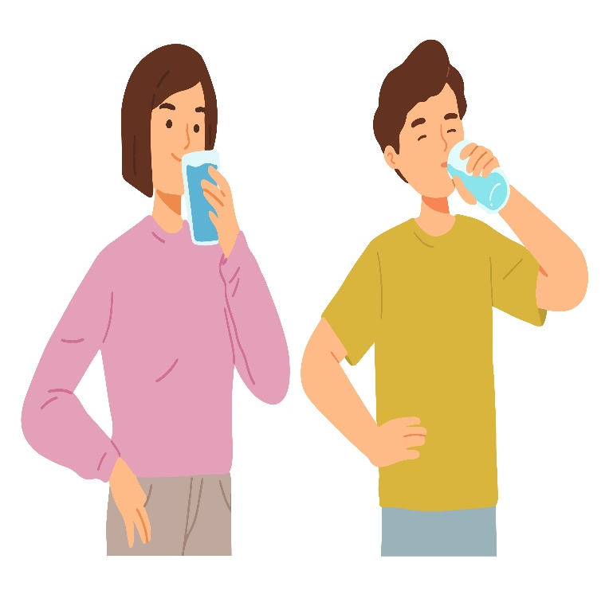
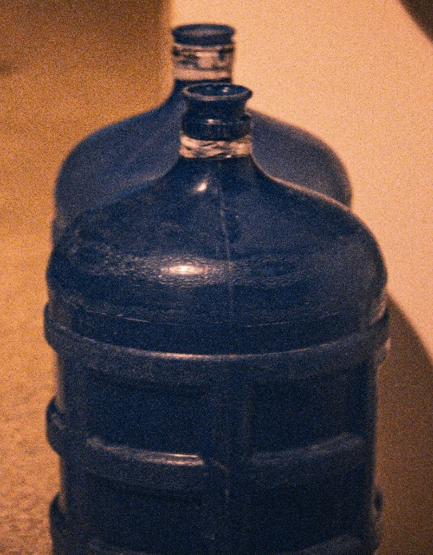
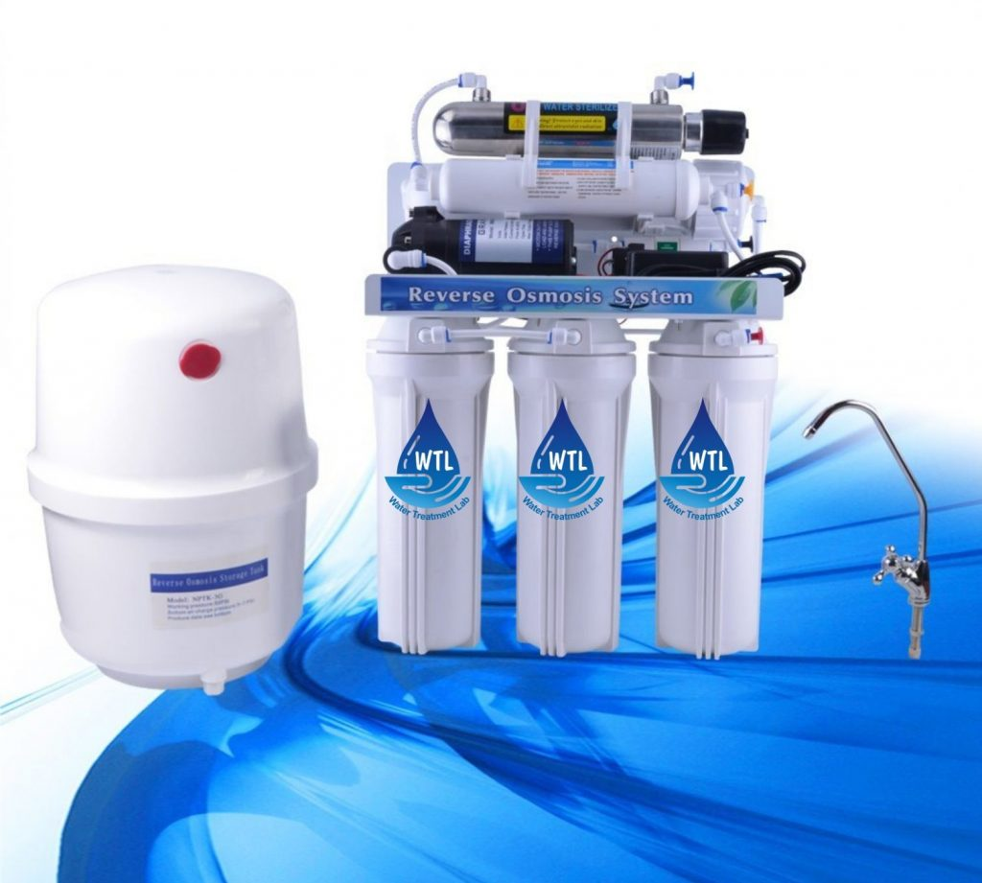
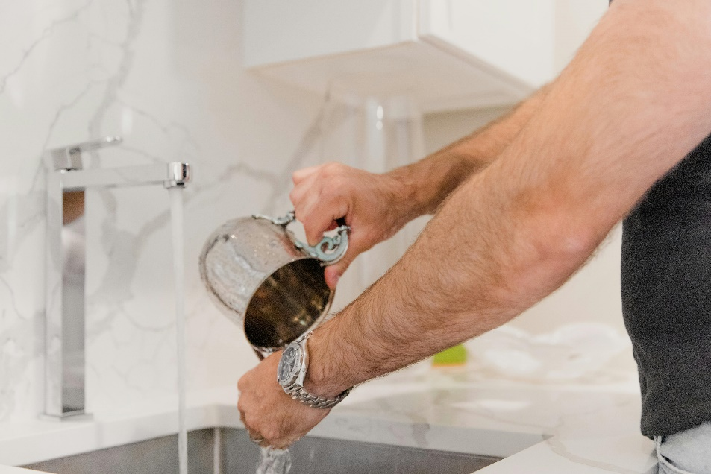
User Cycle
B2C
Filter Shops
End User
Alternatives
Tap Water
Water Gallon
RO Plant
Requires:
Electricity
Installation
Cartridge Replacement (3-6 Months)
Health Risk
Save Upto ~2700 Dhs/10 Months
Effort & Cost in Bringing Home

Slide 7
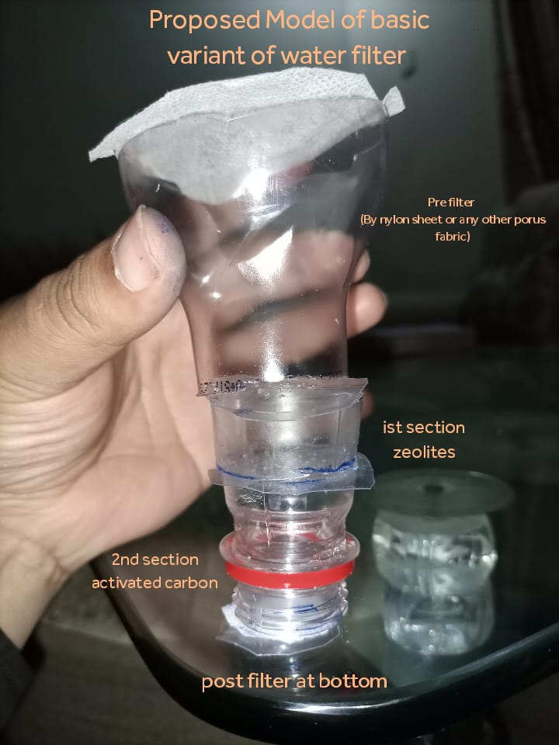
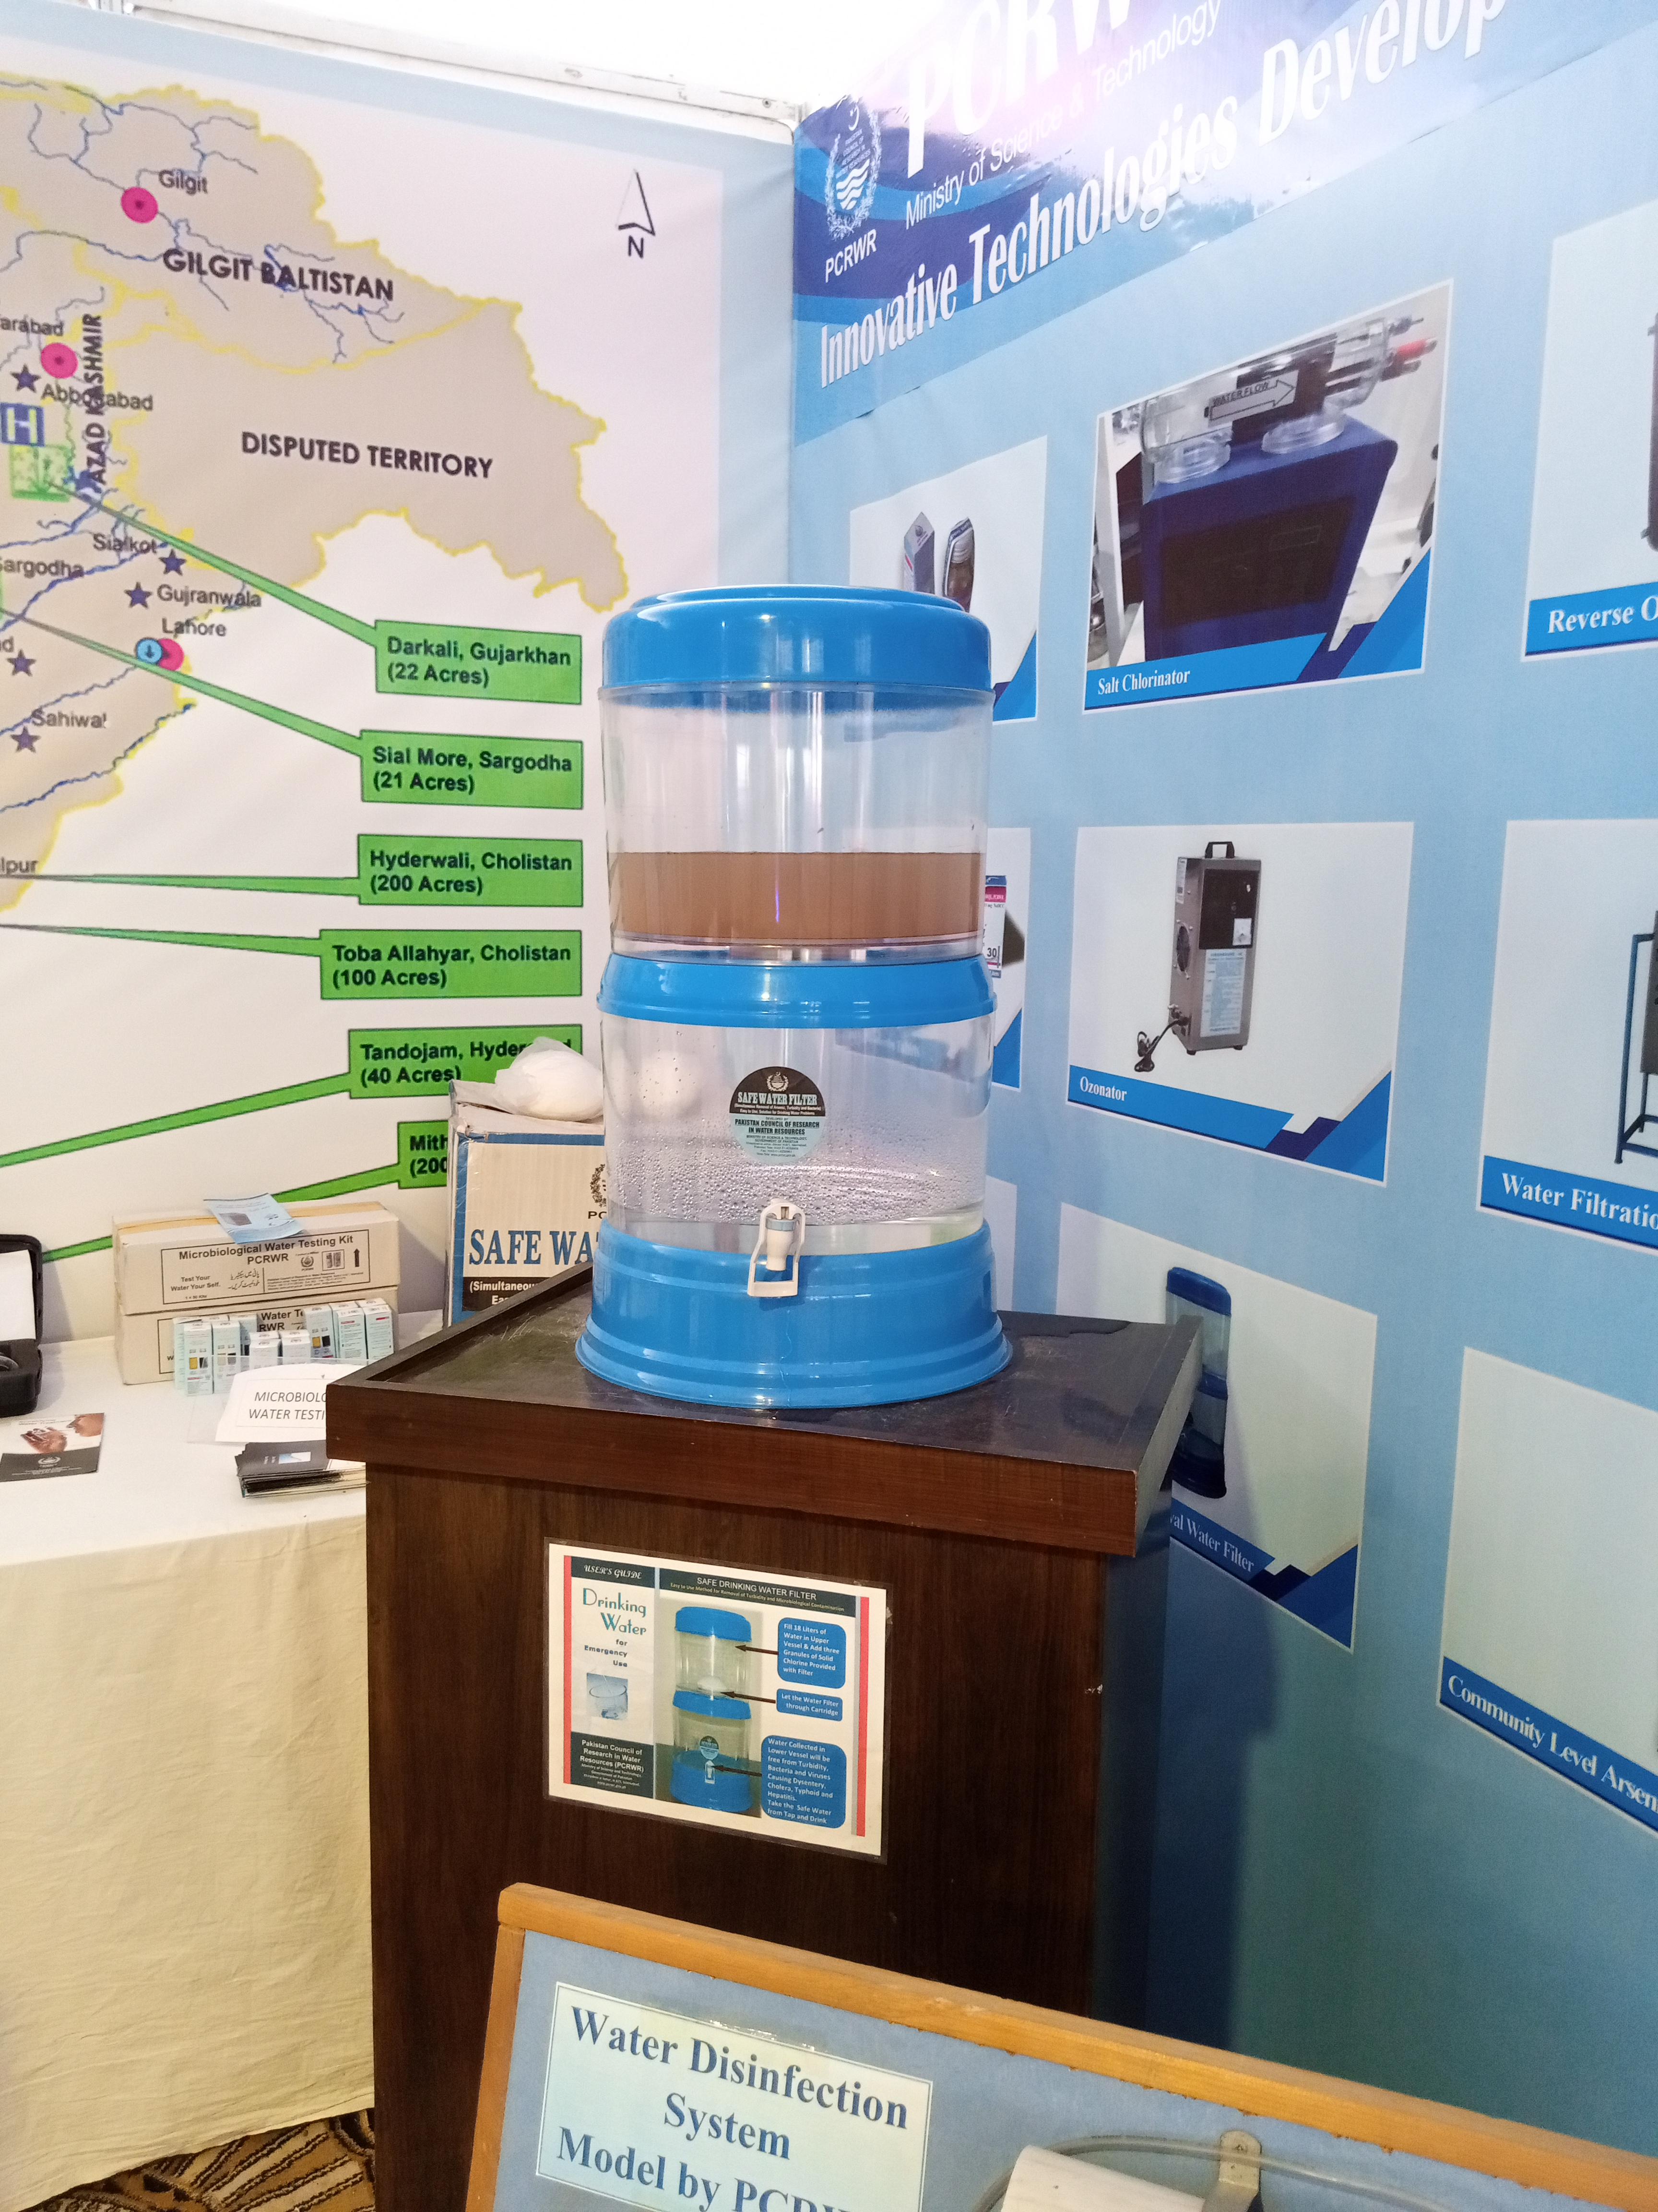
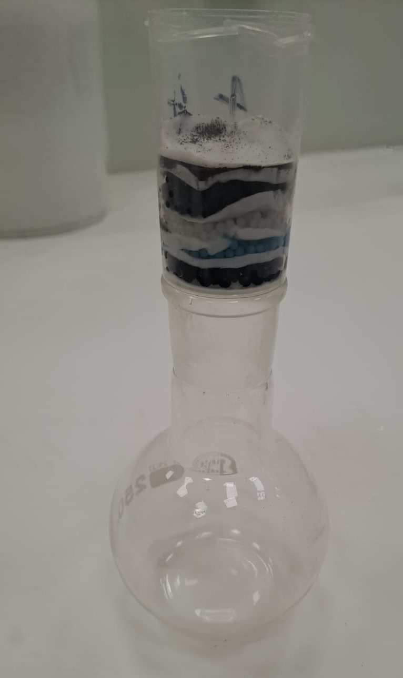

Prototyping
Initial Prototyping
Testing of the Prototype
MVP

Slide 8
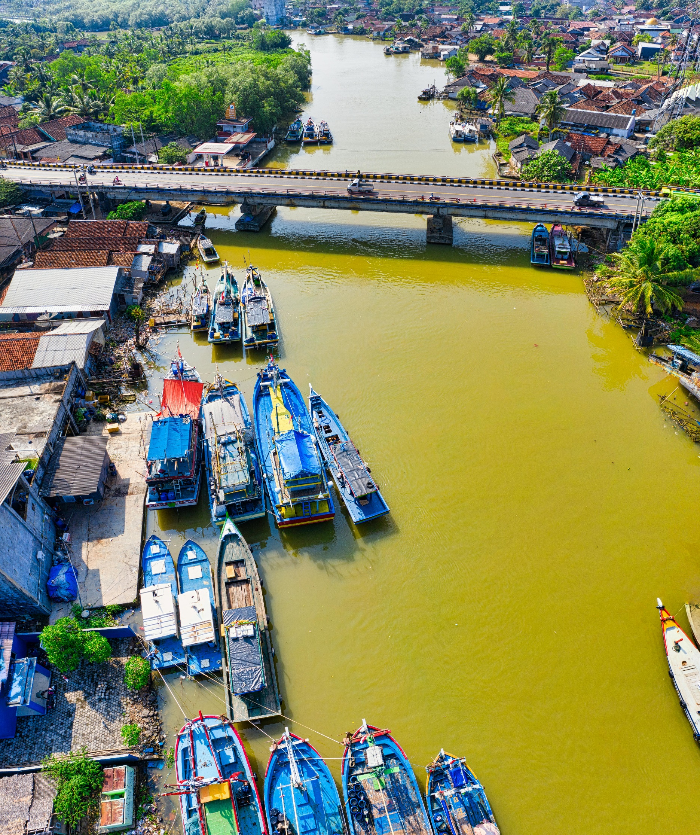
Market
Water Filtration
TAM (Global)
34 Billion Euros
SAM (Africa)
1.5 Billion Euros
SOM (Morocco)
95 Million Euros

Slide 9
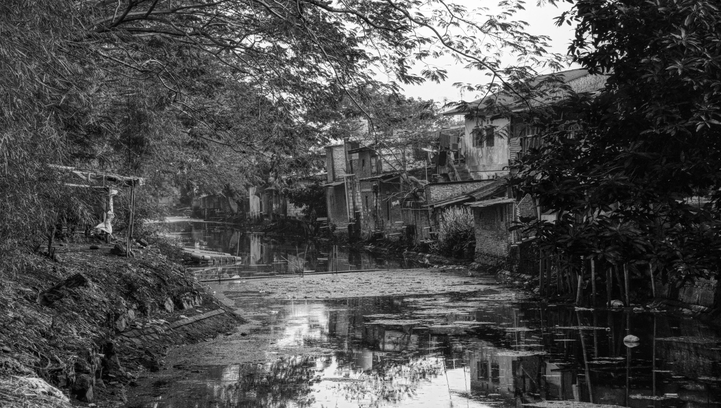
Unit Economics
Selling Price
Product Cost
Net Profit
120
50
70
Prices are in Euro
Notes:
Our selling price for 1 kg of spool is 1200 Rs with a profit margin of 60%

Slide 10
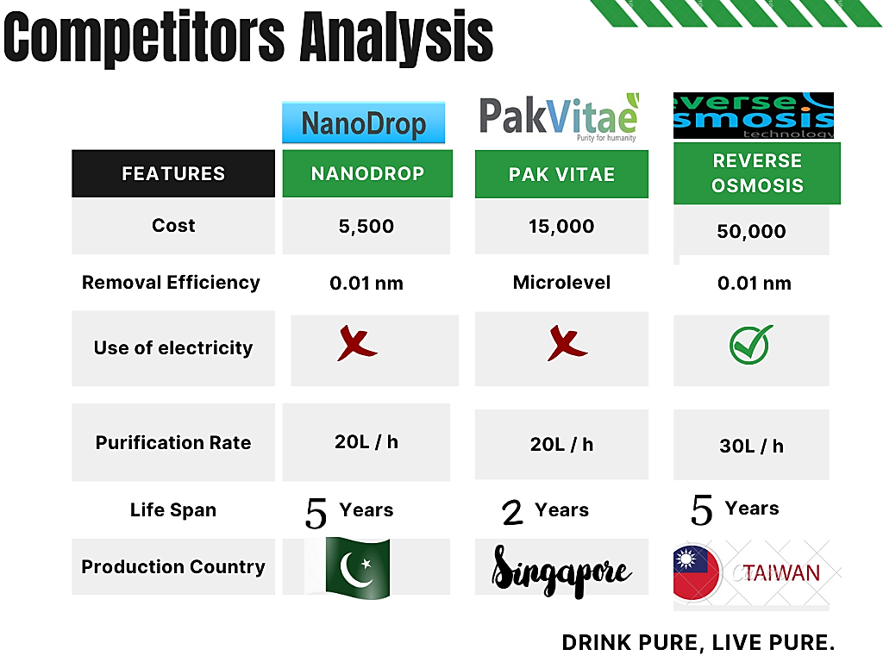



Competitor Analysis
NanoDrop
Pak Vitae
Reverse Osmosis
120 Euros
150 Euros
200 Euros
Nanolevel
Microlevel
Microlevel
2 L/h
10 L/h
10 L/h
~1 Year
~1 Year
~3-6 Months
Singapore
Taiwan

Slide 11
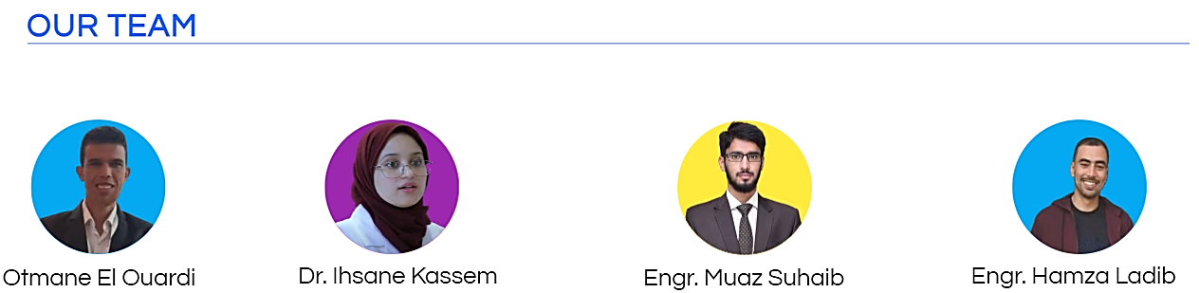










Dr. Soulaima
CMO
Marketing Expert
CTO
Polymer Expert
CEO
Business Expert
COO
Materials Expert
CPO
Membrane Specialist
Notes:
So, why savvy engineers, We are a dynamic and growing team possessing 30+ years of technical and non-technical expertise…myself M.Muaz who is Director and CEO

Slide 12
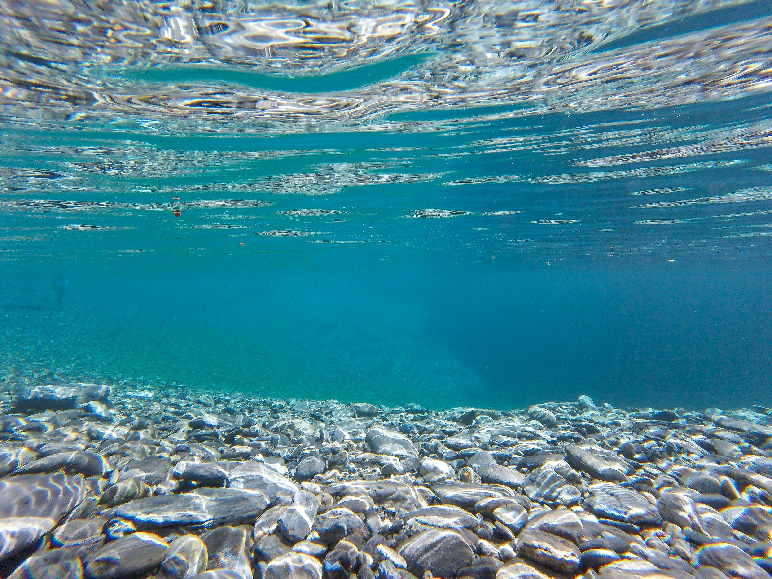
Creating Savvy Solutions That Sustain The Environment
Thank You
https://www.linkedin.com/company/nano-drop
Contact Info: +212 690 705 279

